Slide 1
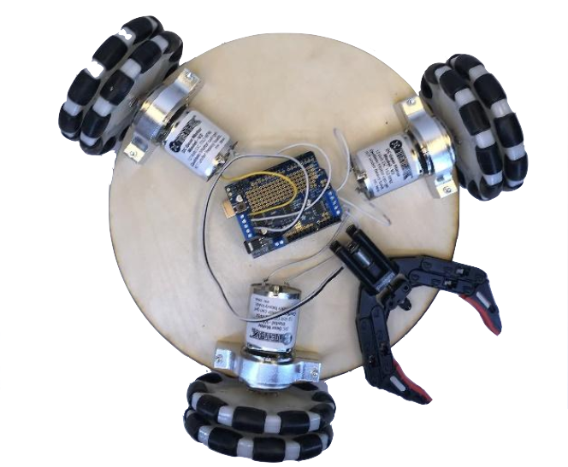

Slide 2
Semi-Autonomous

Slide 3
Semi-Autonomous Omnidirectional

Slide 4
Semi-Autonomous Omnidirectional Manipulation Robot

Slide 5
Semi-Autonomous Omnidirectional Manipulation Robot with Kinect Control

Slide 6
Semi-Autonomous Omnidirectional Manipulation Robot with Kinect Control
Shu You, Nikhila Vembu, Hardik Singh

Slide 7
Problem Statement
We are aiming to display and test how well we can control unmanned robots and drones better with our bodies.
Approach
Electronics
Physical Design
Code
Demo Time!

Slide 8
Problem Statement
We are aiming to display and test how well we can control unmanned robots and drones better with our bodies.
Where ‘gaming controllers’ are limited by their buttons, we can move our body more precisely and in a greater variety of ways, giving us access to improved ways of controlling the robot.
Approach
Electronics
Physical Design
Code
Demo Time!

Slide 9
Agenda

Slide 10
Agenda
Approach
Approach

Slide 11
Agenda
Approach
Electronics
Approach
Electronics

Slide 12
Agenda
Approach
Electronics
Physical Design
Approach
Electronics
Physical Design

Slide 13
Agenda
Approach
Electronics
Physical Design
Overview of the Code
Approach
Electronics
Physical Design
Code

Slide 14
Agenda
Approach
Electronics
Physical Design
Overview of the Code
Demo!
Approach
Electronics
Physical Design
Code
Demo Time!

Slide 15
Approach

Slide 16
Division of Labour
Team Member | Specialization | Group-wide Roles
Nikhila Vembu | - Solidworks Box design - Prototyping - Sensor circuitry design | - Major Project Decisions - Putting things together - Helping with all tasks - Testing entire assembly - Last second problem solving!
Shu You | - Kinect/Arduino interfacing - Kinect gesture design - Robot motion design
Hardik Singh | - Solidworks Robot Base Design - Robot base assembly - Robot circuitry design
Electronics
Physical Design
Code
Demo Time!
Approach

Slide 17
Approach
Critical decision points with the project
Size of the overall robot and finding things that matches
Making sure kinect -> python -> arduino -> motors was all compatible
Narrowing down our focus onto a specific purpose was not easy
Iterations in our design
Mostly conservative iterations based on feasibility
Our initial focus was overall fairly realistic and we were able to execute
Reach for the stars but be ready to find an alternative. Don’t brute force it.
Electronics
Physical Design
Code
Demo Time!
Approach

Slide 18
Electronics

Slide 19
Electronics
Microprocessors
Two Arduino UNO
Actuators
Three DC motors
One gripper with DC motor
Sensors
Two Elegoo HC-SR04 proximity sensors
Microsoft Kinect
Additional Components
One Adafruit V2 Motor Shield
One HC-05 Bluetooth Module
Approach
Physical Design
Code
Demo Time!
Electronics

Slide 20
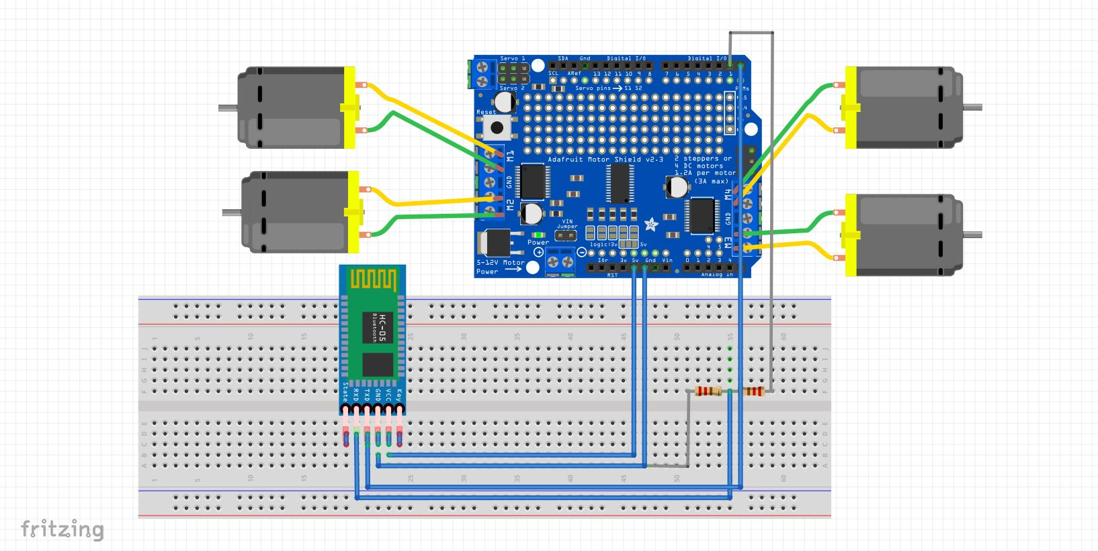
Main Circuit Schematics
Three DC motors for three wheels. One DC motor for gripper.
HC-05 Bluetooth module for wireless serial port communication.
Approach
Physical Design
Code
Demo Time!
Electronics

Slide 21
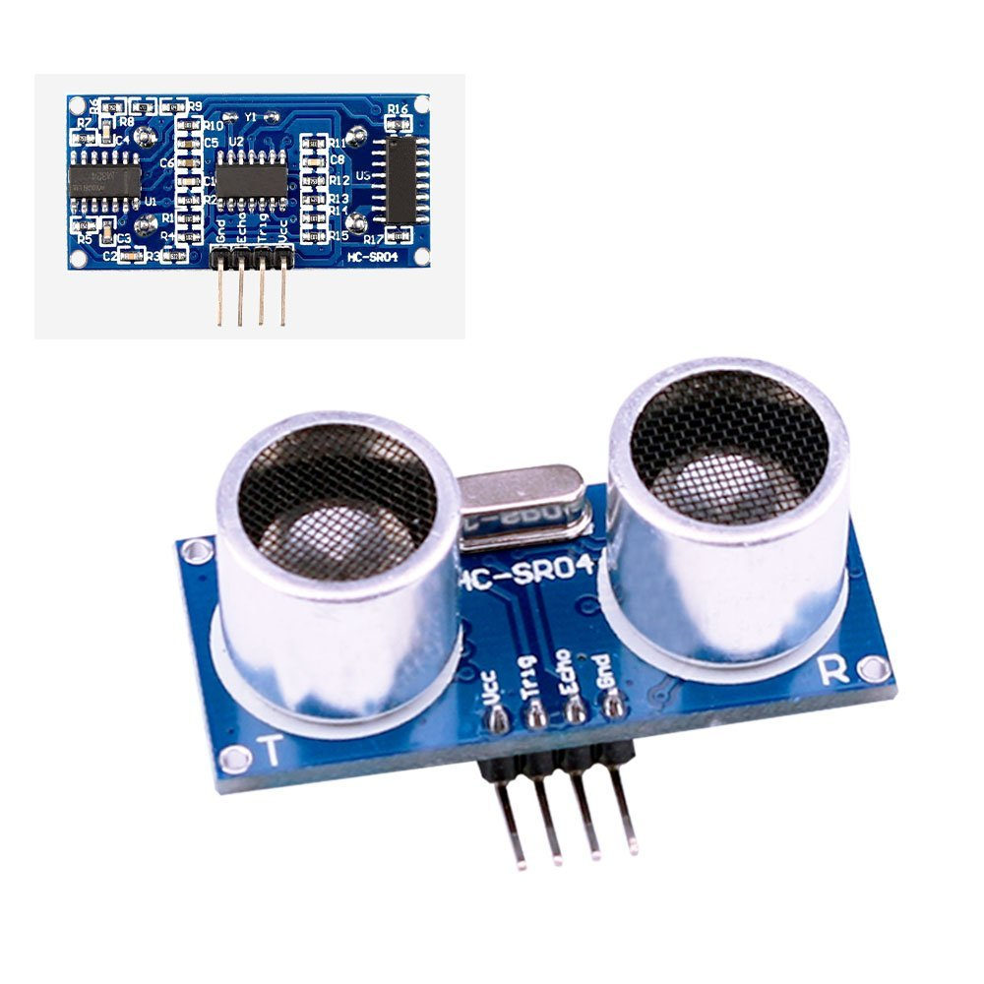
Distance Sensor
Receiver(Echo Pin) receives reflected sound
Used Elegoo HC-SR04 Ultrasonic
Module Distance Sensor
Excellent accuracy from 2cm
to 400 cm
Transmitter (Trig Pin) sends high freq. sound
Approach
Physical Design
Code
Demo Time!
Electronics

Slide 22
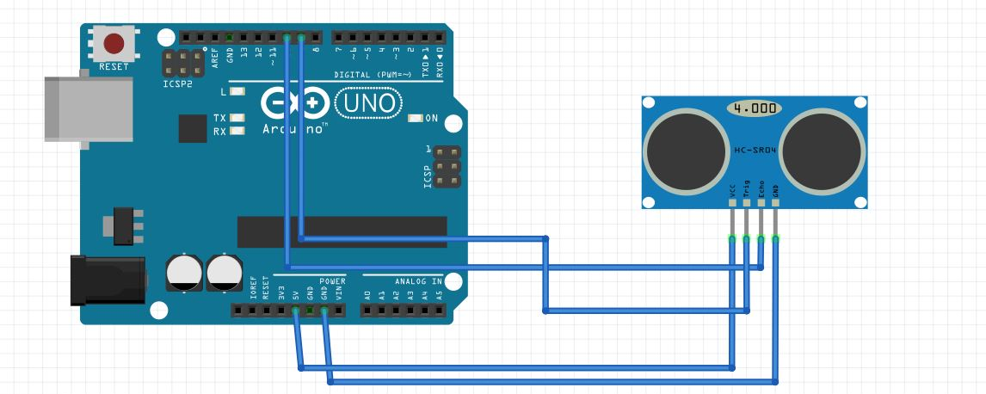
Distance Sensor Schematics
Approach
Physical Design
Code
Demo Time!
Electronics

Slide 23
Physical Design

Slide 24
Physical Parts
Balsa Wood
Motors & Motor Mounts
OmniWheels!
Mechanical Gripper
Electronics & Batteries
Approach
Physical Design
Code
Demo Time!
Electronics

Slide 25
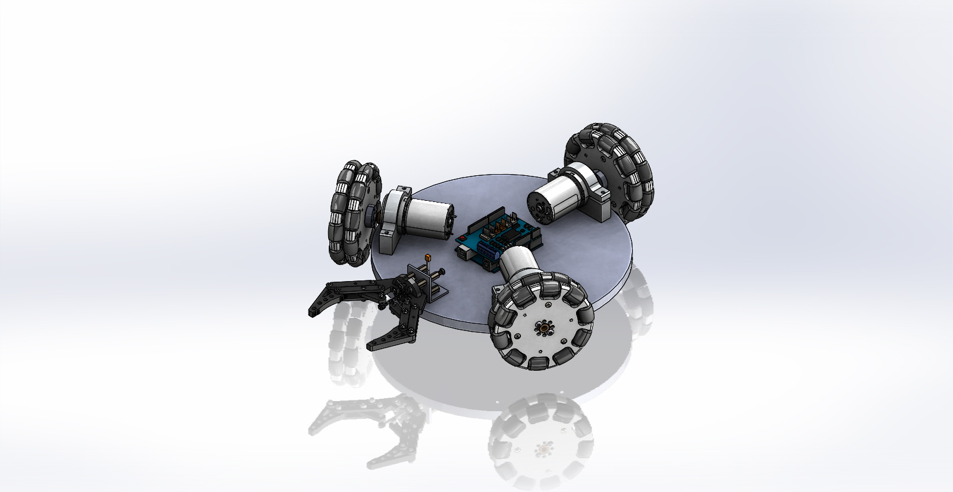
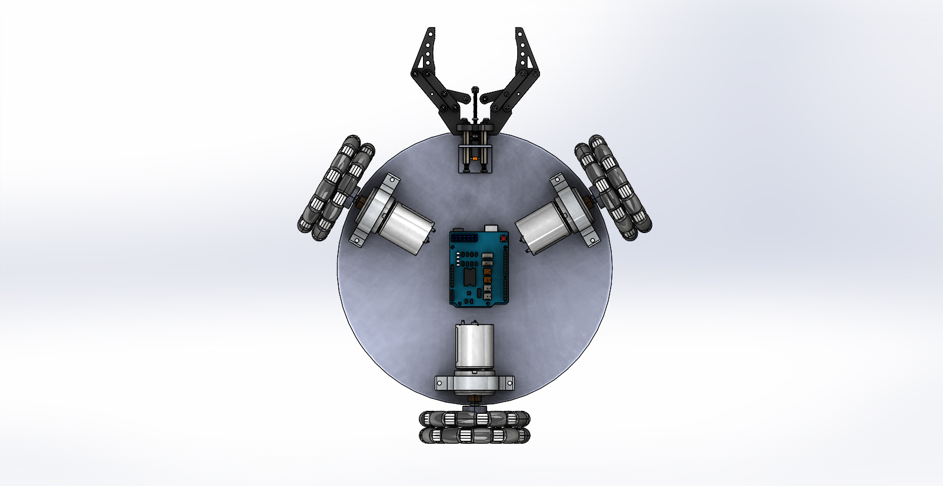
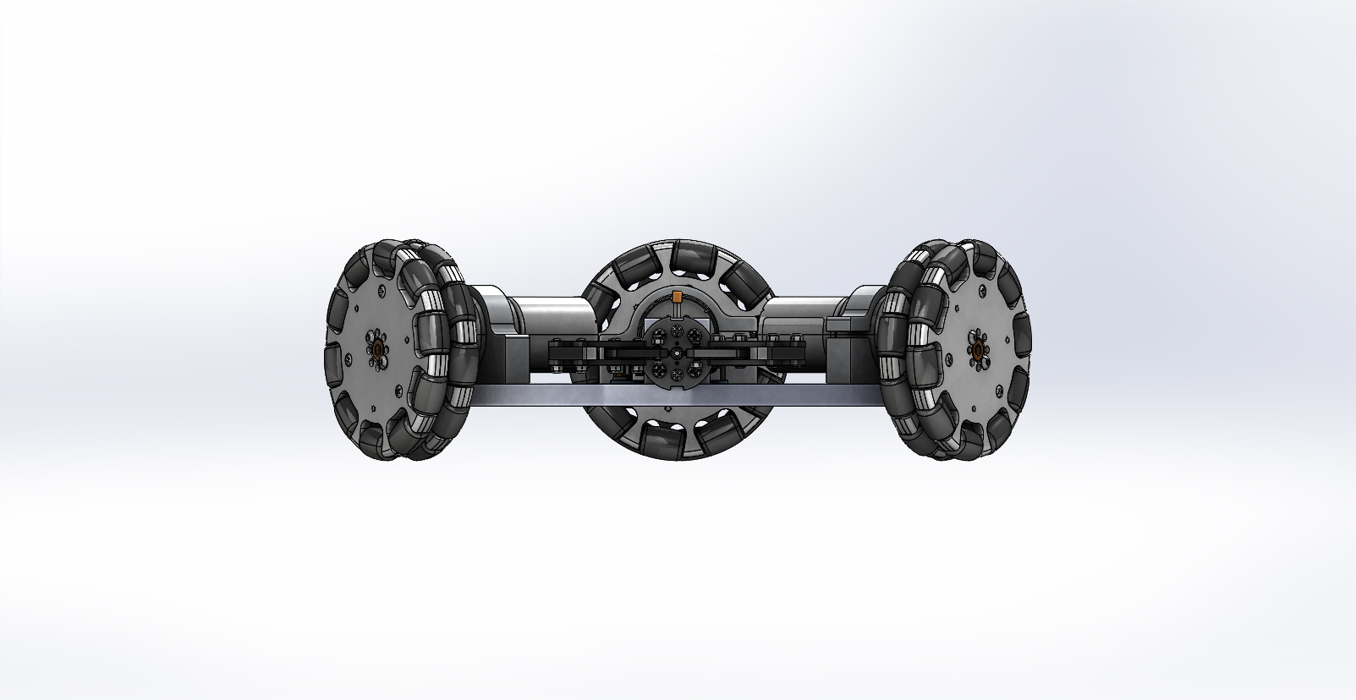
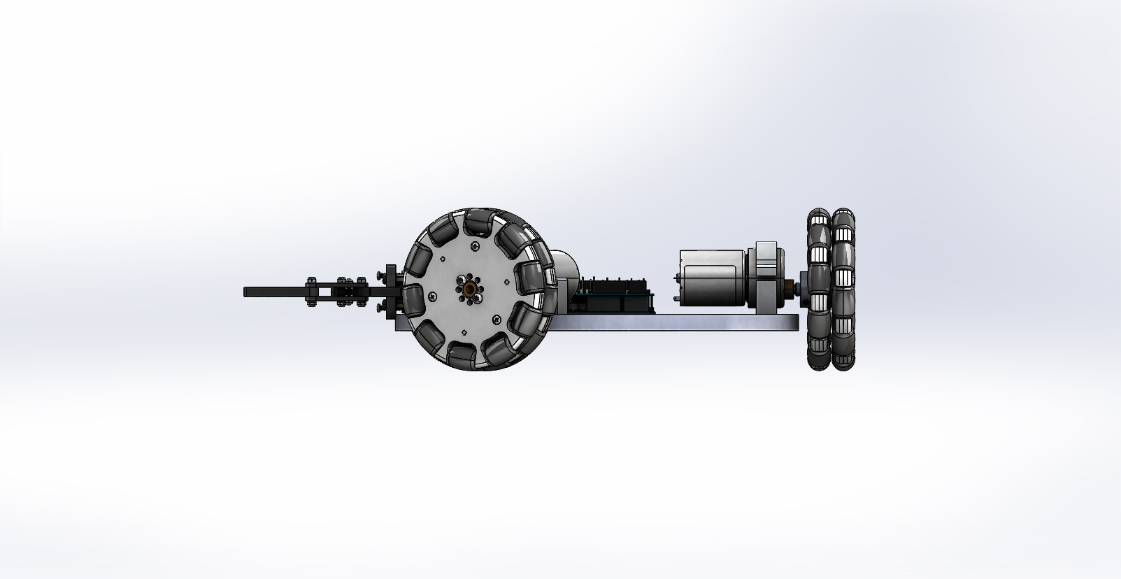
Physical Base Design - CAD
Approach
Electronics
Code
Demo Time!
Physical Design

Slide 26
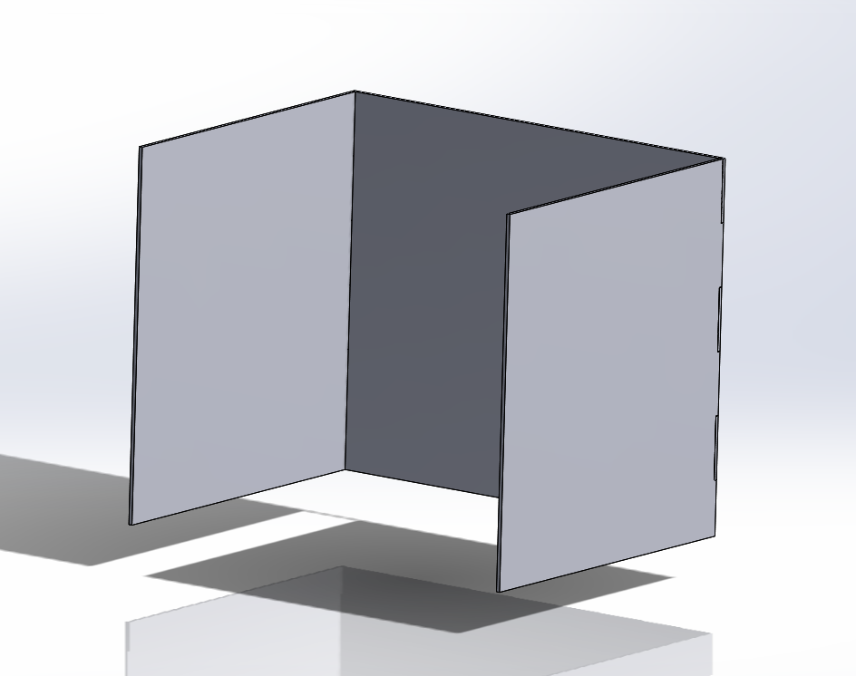
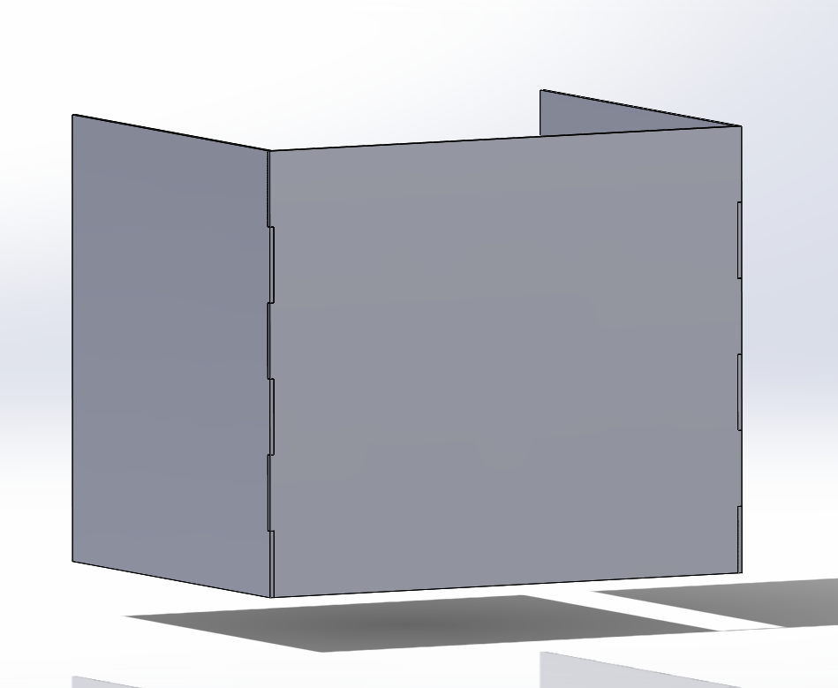
Physical Box Design - CAD
Robot has to be directed into this open box
Teeth between back walls and side walls for stability
Approach
Electronics
Code
Demo Time!
Physical Design

Slide 27
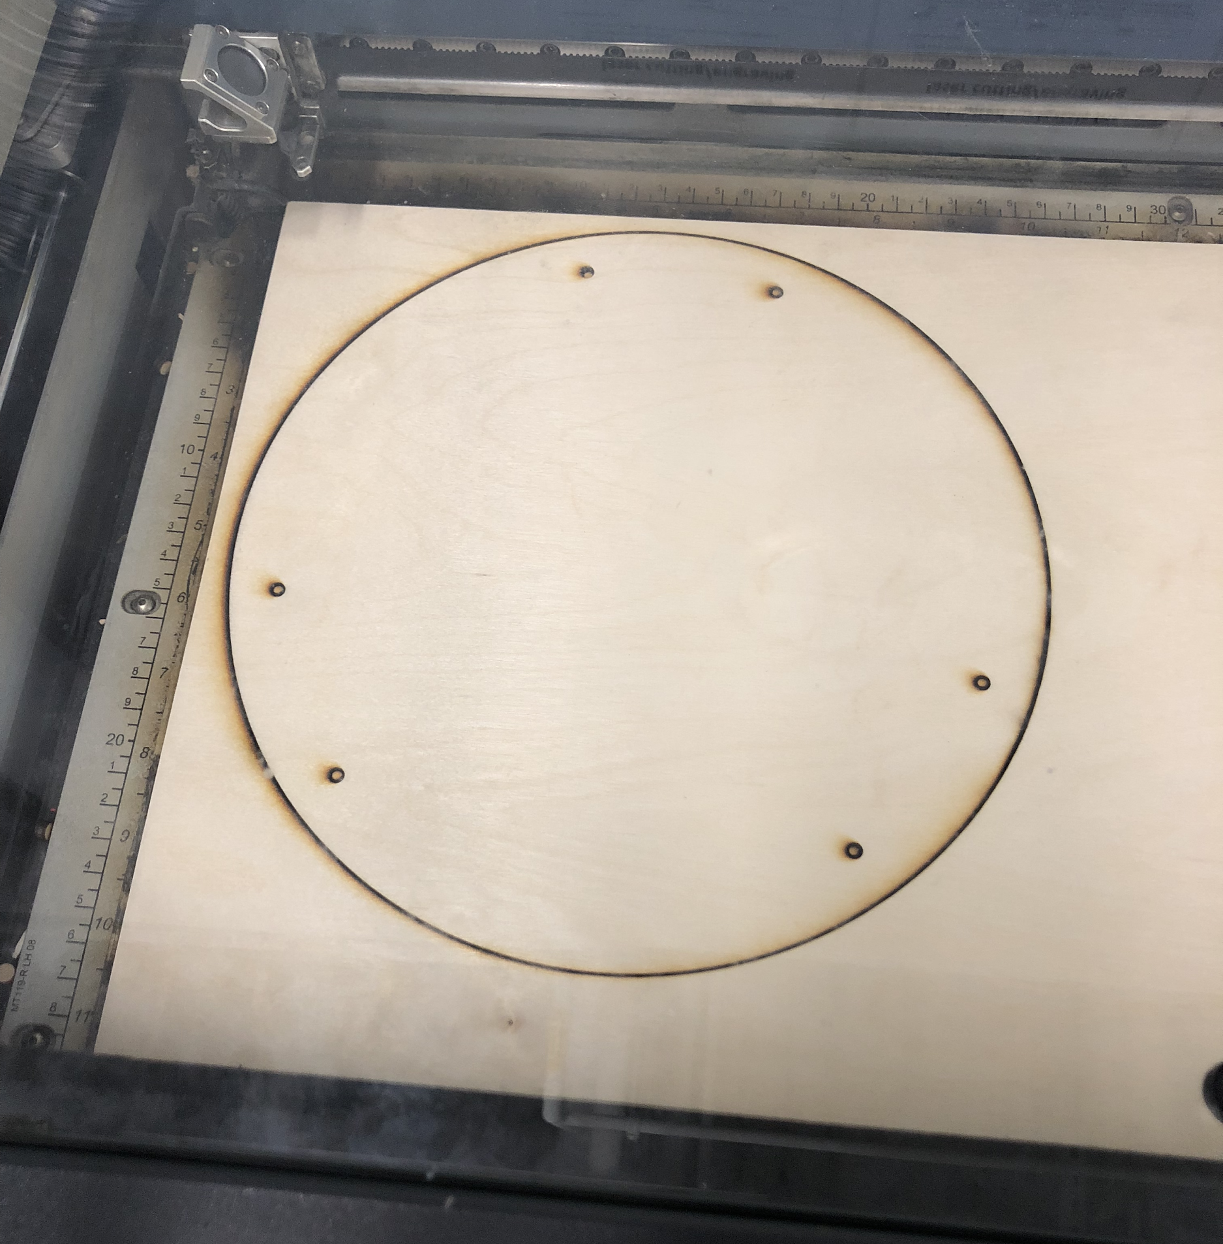
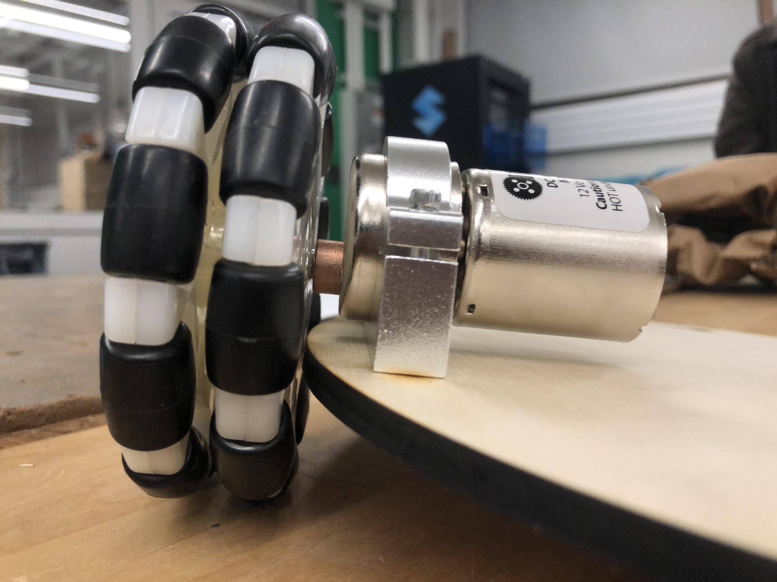
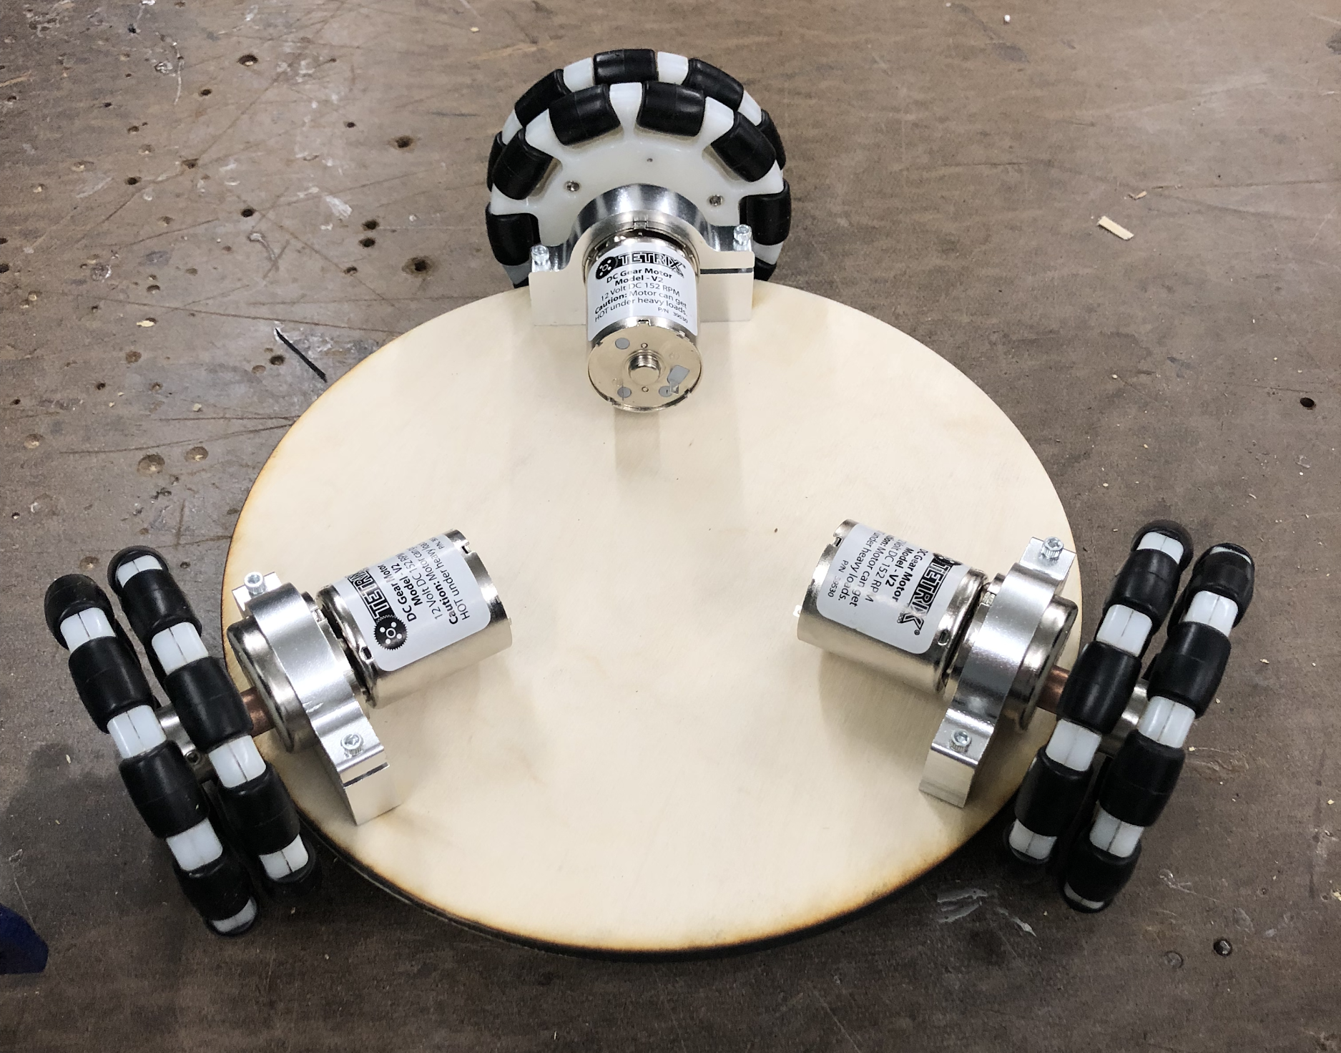
Physical Base Design - Assembly
Approach
Electronics
Code
Demo Time!
Physical Design

Slide 28
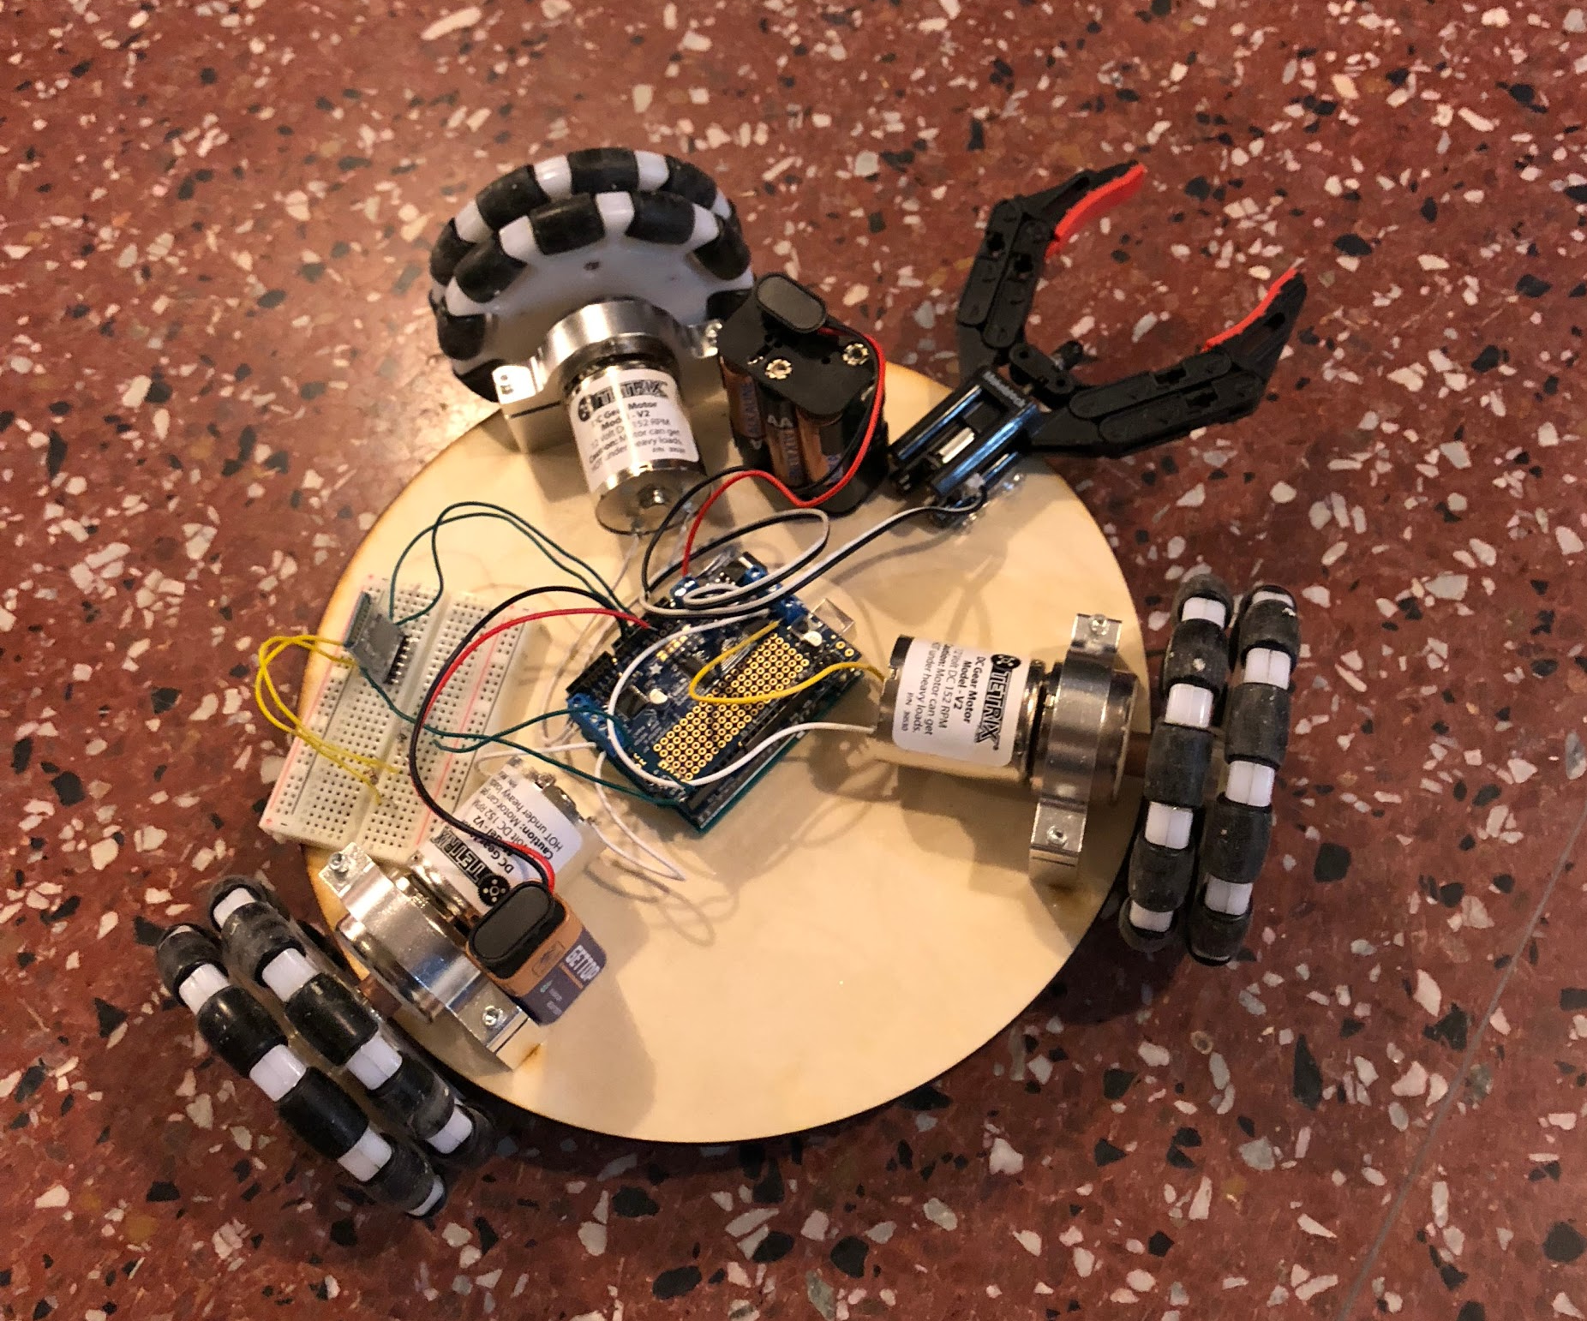
Physical Base Design - Final
Approach
Electronics
Code
Demo Time!
Physical Design

Slide 29
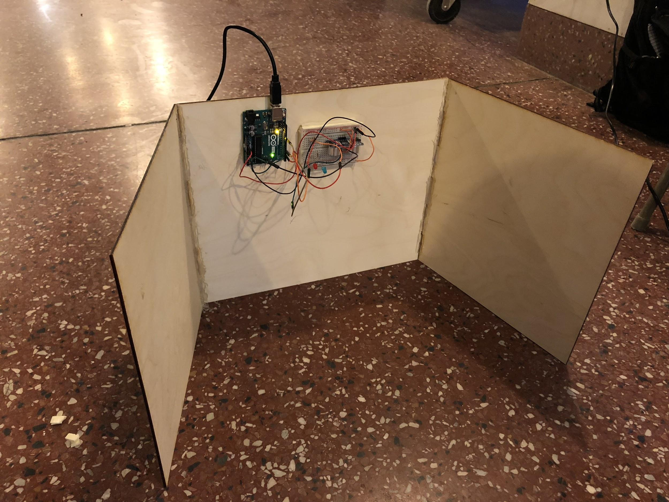
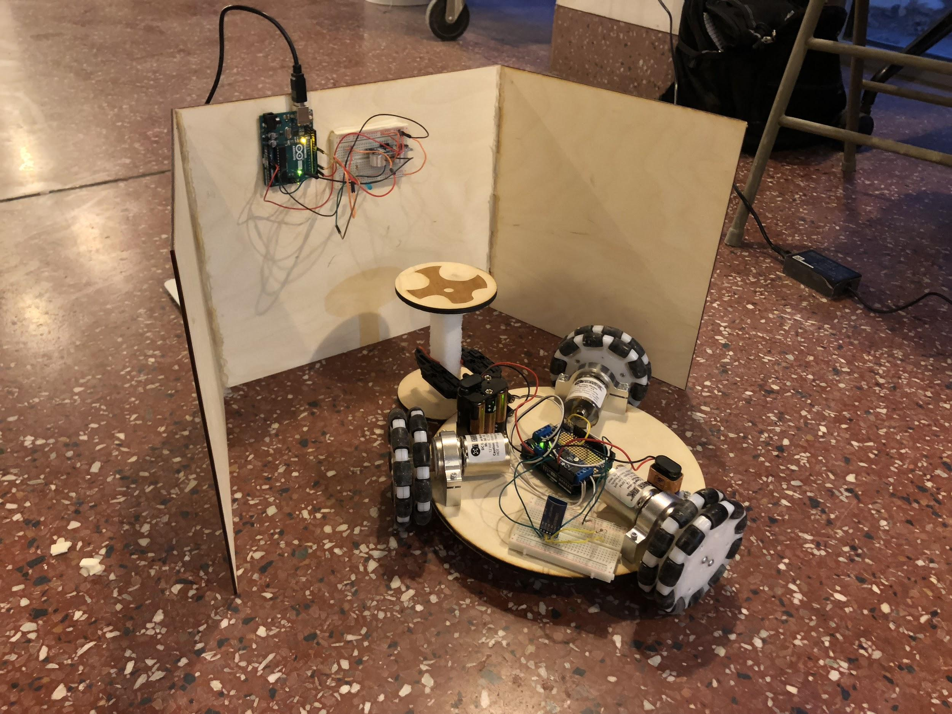
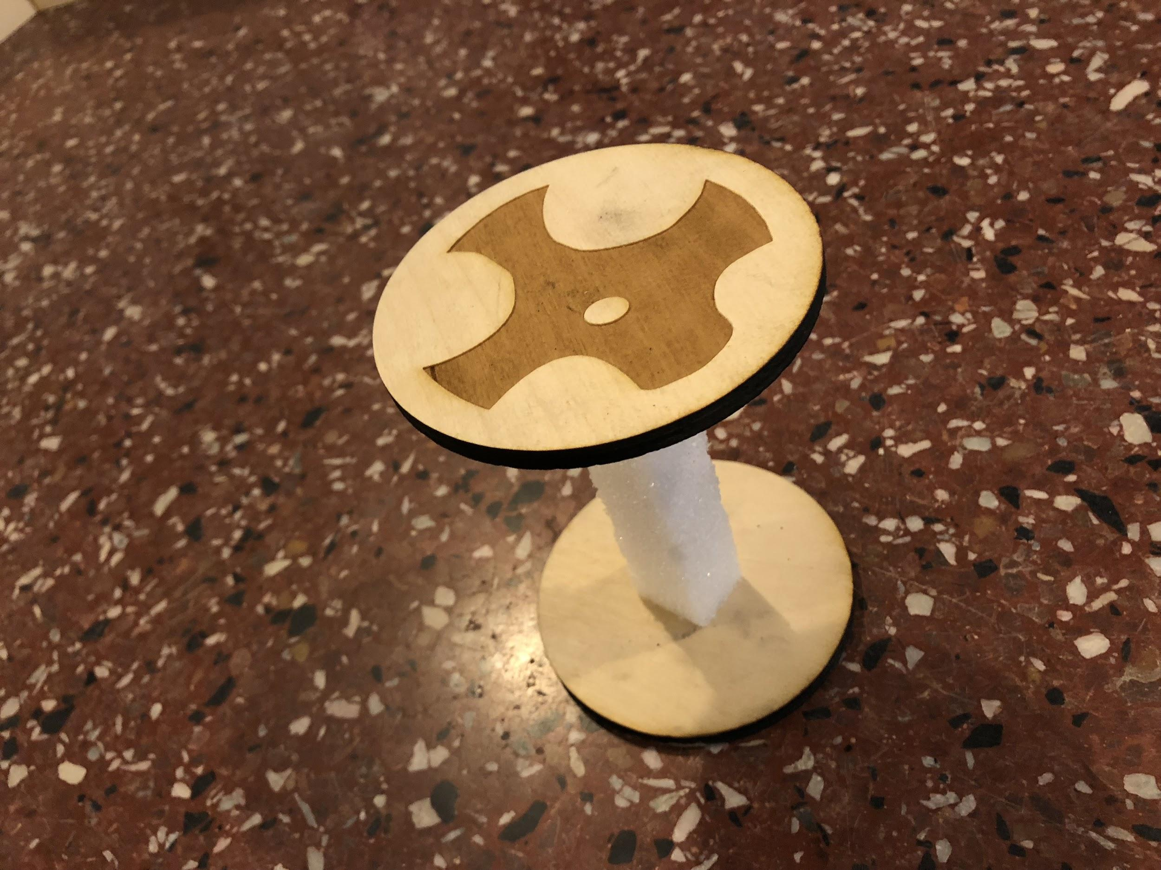
Physical Design - Final Parts
Approach
Electronics
Code
Demo Time!
Physical Design

Slide 30
Code Overview

Slide 31
Code
Kinect (Python)
Read human gesture and communicate with Arduino over serial port
Arduino (Code for main robot + Code for sensors)
Robot motion
Proximity sensor
Approach
Electronics
Physical Design
Demo Time!
Code

Slide 32
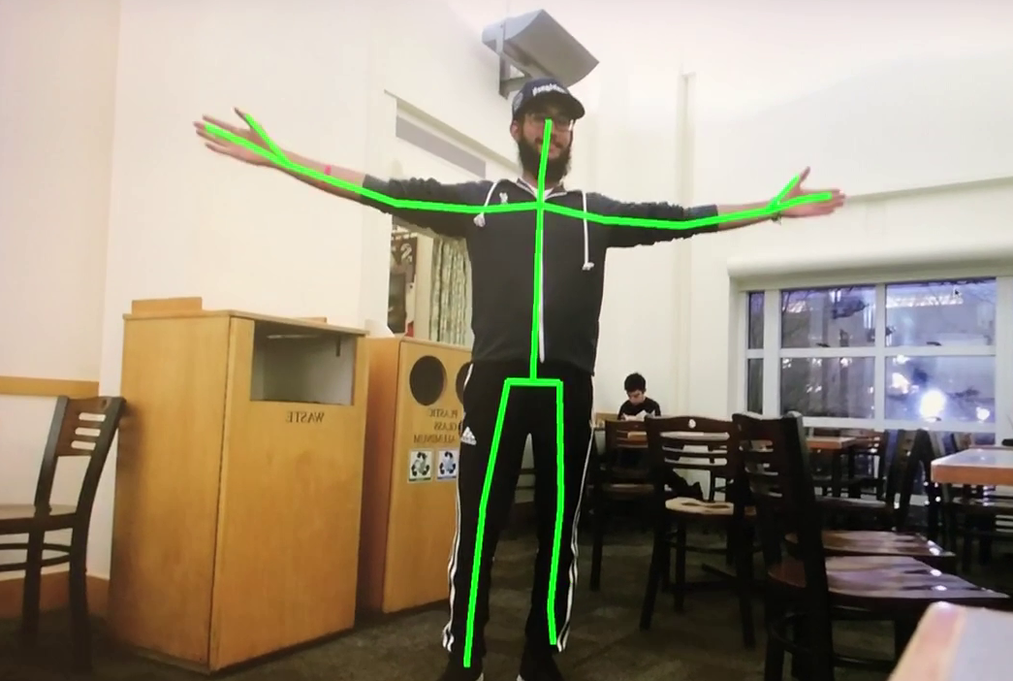
Kinect
Read body joints and save (x, y, z) coordinates.
Do calculations based on joints coordinates.
Approach
Electronics
Physical Design
Demo Time!
Code

Slide 33
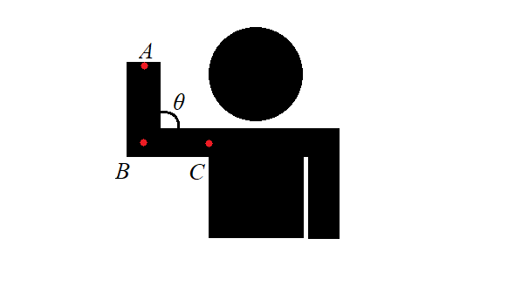
Kinect
Take (x, y) coordinates of points A, B, and C.
Use Pythagorean Theorem to calculate AB and BC.
Use dot product to calculate the angle θ.
We designed 8 gestures.
Approach
Electronics
Physical Design
Demo Time!
Code

Slide 34
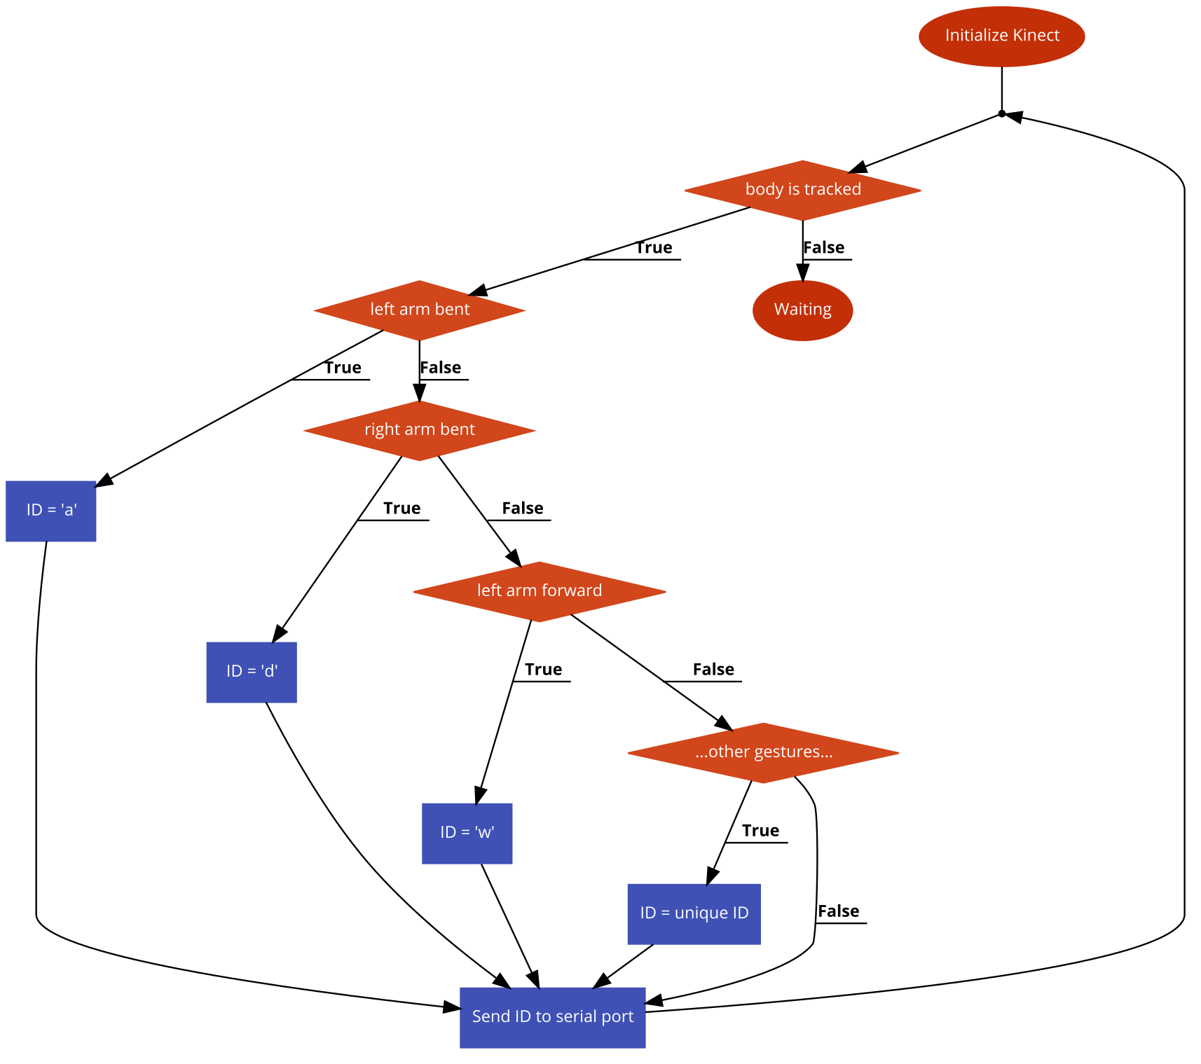
Kinect code flowchart
Read gesture
Map gesture to a unique ID
Send ID to serial port
Python Library: PyKinectV2 Math serial pygame
Approach
Electronics
Physical Design
Demo Time!
Code

Slide 35
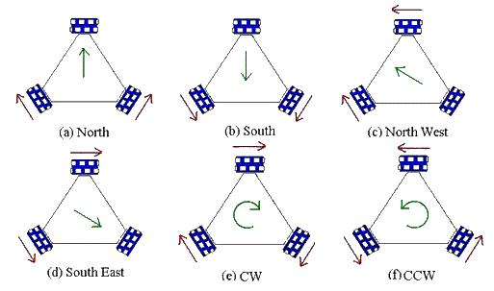
Arduino (Robot)
Control DC motor speed and spinning direction.
Example: Forward motion
Approach
Electronics
Physical Design
Demo Time!
Code

Slide 36
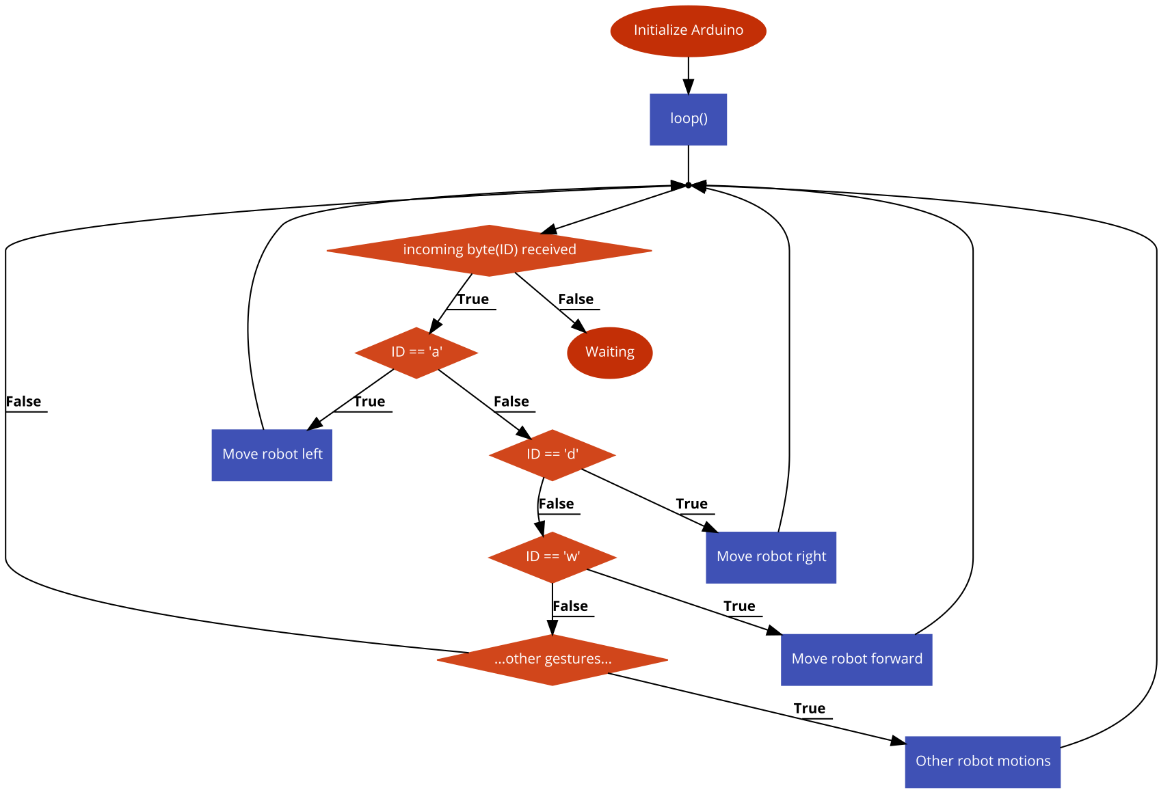
Arduino (Robot) code flowchart
Arduino Library: Motor shield library
Read ID from serial port.
Map ID to a specific motion helper function (e.g. moveForward()).
Execute motion and wait for next incoming ID.
8 gestures map to 8 motions.
Approach
Electronics
Physical Design
Demo Time!
Code

Slide 37
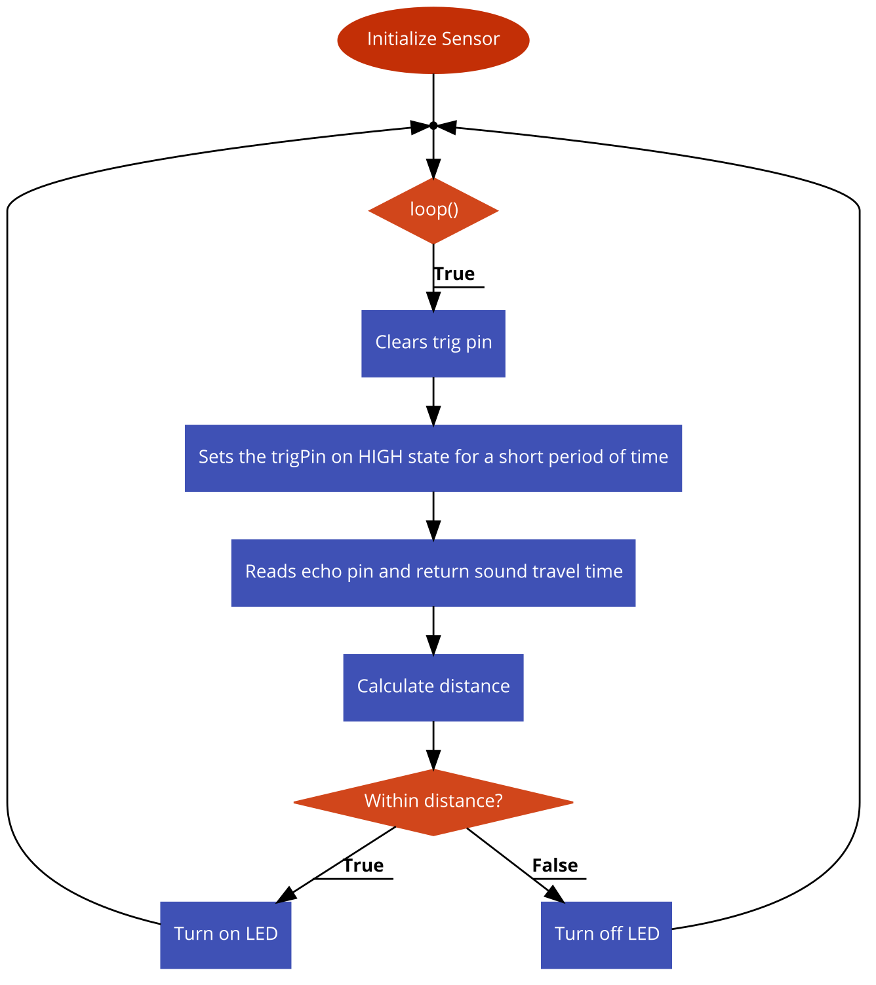
Arduino (Sensor) code flowchart
Temporary short low pulse ensures we get a clean HIGH pulse (trig pin).
Approach
Electronics
Physical Design
Demo Time!
Code

Slide 38
Demo Time!
Approach
Electronics
Physical Design
Code
Demo Time!

Slide 39
Reflections

Slide 40
Reflections
We learned a lot, and we’re glad we stepped out of our comfort zones

Slide 41
Reflections
We learned a lot, and we’re glad we stepped out of our comfort zones
No encoder was a risk - but a worthy one to stay under budget

Slide 42
Reflections
We learned a lot, and we’re glad we stepped out of our comfort zones
No encoder was a risk - but a worthy one to stay under budget
Controlling with the body is fun! But is it practical in the real world?

Slide 43
Reflections
We learned a lot, and we’re glad we stepped out of our comfort zones
No encoder was a risk - but a worthy one to stay under budget
Controlling with the body is fun! But is it practical in the real world?
Where we could have improved
We purchased every part - motor and motor attachments came hand in hand, gripper too
Having a more sophisticated method of lifting objects

Slide 44
Hope you enjoyed!

Slide 45
?

